Slide 1

Evidence-Based Reading
Comprehension
Presented by Michael Tilley
April 13, 2021
This presentation will be recorded and shared for on-demand viewing.

Slide 2
Background on Evidence-Based Reading
Phonics
Vocabulary
Fluency
Comprehension
Phonemic Awareness
Components of Evidence-Based Reading Instruction
Notes:
In its simplest form, evidence-based reading instruction means that a particular program or collection of instructional practices has a record of success. That is, there is reliable, trustworthy, and valid evidence to suggest that when the program is used with a particular group of children, the children can be expected to make adequate gains in reading achievement. Other terms that are sometimes used to convey the same idea are research-based instruction and scientifically based research
There is no single instructional program or method that is effective in teaching all children to read. Rather, successful efforts to improve reading achievement emphasize identification and implementation of evidence-based practices that promote high rates of achievement when used in classrooms by teachers with diverse instructional styles with children who have diverse instructional needs and interest
n as the First-Grade Studies (Bond & Dykstra, 1967/1997). This series of U.S. federally funded investigations examined popular approaches to teaching beginning reading. Included were examinations of basal reading, phonics, language experience, and linguistics approaches to reading instruction. The collection of 27 studies comparing different methods and materials found as many differences between and among teachers using the same program or approach as there were between and among teachers using different programs or approaches, leaving the authors unable to identify a “best” program. Instead, the results led the authors to conclude, Children learn to read by a variety of materials and methods.... No one approach is so distinctly better in all situations and respects than the others that it should be considered the one best method and the one to be used exclusively. (Bond & Dykstra, 1967/1997, p. 416)

Slide 3
Overview
Define reading comprehension and its role as an essential component of reading
Examine how to assess a student’s reading comprehension skills
Evaluate metacognitive strategies to self-regulate reading behavior
Compare strategies for teaching reading comprehension

Slide 4

Comprehension 101
Process and product of understanding text
High level of metacognitive engagement with text
Construct meaning from text as one reads
Notes:
-Comprehension Defined: Reading comprehension is the process and product of understanding text, and requires a high level of metacognitive engagement with text. Comprehension is the end goal of reading, whether an individual reads for pleasure, to learn, or to locate information. It is "the process of simultaneously extracting and constructing meaning through interaction and involvement with written language" (Snow, 2002). Individuals construct meaning from text as they read, absorbing new information and comparing it to their pre-existing knowledge. Readers are able to comprehend text only if the other key components of reading—alphabetics, fluency, and vocabulary—are in place (Curtis & Bercovitz, 2004). While reading, an individual decodes words (alphabetics), associates the words with meanings stored in memory (vocabulary), and processes the phrases and sentences rapidly enough (fluency) that meaning is not forgotten during the reading process (Kruidenier, 2002b).

Slide 5
Essential Component of Reading
Poor functional literacy comprehension
Simple daily comprehension tasks vs. integrating and synthesizing information
Monitoring and metacognition skills
Notes:
Many adult learners enrolled have poor functional literacy comprehension. Adult learners may be able to perform daily comprehension tasks, such as locating a piece of information in a simple text, but be unable to integrate or synthesize information from longer or more complicated texts (Kruidenier, 2002b). In some cases, learners are unable to comprehend texts because they need additional background knowledge or vocabulary, but many learners struggle with comprehension because they have not yet developed a repertoire of strategies for monitoring and supporting their comprehension (Curtis & Longo, 1997). Some learners view reading solely as decoding and do not actively consider comprehension (Gambrel & Heathington, 1981). Other readers struggle with comprehension because they are unfamiliar with various types of texts, such as poems, narratives, or expository texts. Not surprisingly, reading a wide variety of text types is associated with high scores on the National Adult Literacy Survey (Smith, 1996). Studies show that explicitly teaching comprehension in combination with other reading components can improve student comprehension (Kruidenier, 2002b). Some researchers suggest that the way skills are currently taught may be too narrowly focused on learners' functional levels or on extracting information, at the expense of engaging learners in actively constructing meaning (Weiner, 2006).

Slide 6
Assessment of Comprehension
When to assess?
Provide timely feedback
Utilize a range of assessments
Assess with informal reading inventories
Notes:
To find the correct reading level for learners, programs should assess learners as soon as they enter the reading program. Learners will not make gains in reading if they are assigned materials that are at the wrong reading level. Curtis and Bercovitz (2004) explain that "if the material is too difficult, learners will expend all their efforts decoding and won't be able to think about comprehension." Learners also benefit from the specific information assessment gives them about their strengths and weaknesses in reading. Equipped with a profile of their reading abilities, they can track their own progress, use the information for self-evaluation, and note their personal growth (Kruidenier, 2002a). One type of assessment cannot fully capture the range and depth of a learner's comprehension skills. Programs often assess learner comprehension using silent reading tests in which learners read passages and answer multiple-choice questions. There is no consensus on the validity of these standardized tests (e.g., the Test of Adult Basic Education [TABE] Reading Comprehension) because student performance can vary greatly on multiple administrations of the same test (Perin & Greenberg, 1993; Venezky, Bristow, & Sabatini, 1994). For a more complete picture of learners' comprehension skills, learners should be assessed orally as well as with written instruments. Retelling is one form of easily administered oral assessment. After silently reading a passage at a level that the learner can easily decode, the learner explains to the teacher what he or she has just read. Teachers look for accuracy, completeness, and organization in the retelling. Another way to assess learners' comprehension skills is to conduct informal reading inventories (IRIs) (McShane, 2005). IRIs are administered by asking students to read passages and orally respond to questions posed by the teacher. Using this format, teachers can address issues related both to the text (e.g., asking about specific items in the passage) and to the reader's interpretation of the text (e.g., asking about the implications of the passage).

Slide 7
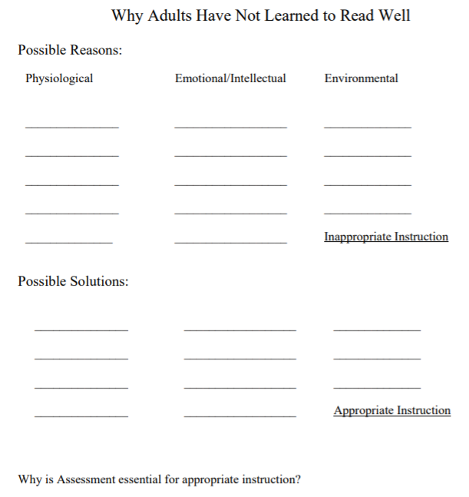
Breakout Room Activity: Why Adults Have Not Learned to Read Well
Identify possible reasons adults have not learned to read well
Identify possible solutions to these reasons
Discuss why assessment is essential for appropriate instruction
Notes:
https://docs.google.com/document/d/1M27JxFoeVz-Pkj45eut6eKe6gG6LgLNJUIbQMVPxVAQ/edit?usp=sharing

Slide 8

Readability of Texts
Independent Level
Instructional Level
Frustration Level
Notes:
INDEPENDENT LEVEL: text in which no more than approximately 1 in 20 words is difficult for the reader. Accuracy level: 95-100% Independent-level texts are appropriate if students are reading independently with little or no instructional support. Independent-level texts are often used to build fluency.
• INSTRUCTIONAL LEVEL: text in which no more than approximately 1 in 10 words is difficult for the reader. Students need instructional support from the teacher. Accuracy level: 90-94% Instructional-level texts are appropriate for small-group instruction when teachers provide assistance as students read.
• FRUSTRATIONAL LEVEL: text in which more than 1 in 10 words are too difficult for the reader. Accuracy level: less than 90% Frustrational-level texts can be used when extensive support and instruction are provided by the teacher during one-on-one instruction.

Slide 9
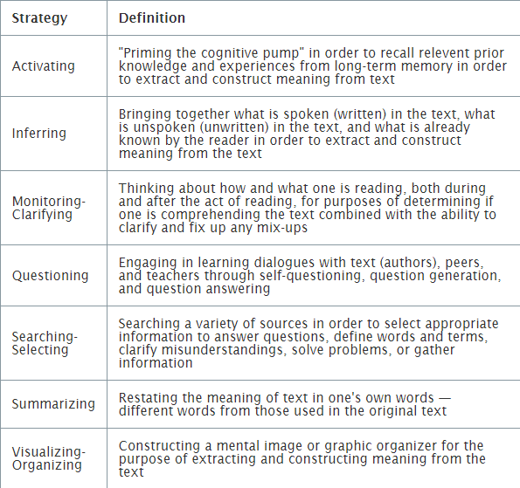
Metacognitive Strategies of Effective Readers
Notes:
Metacognition, or thinking about one's thinking, is the foundation for other reading comprehension strategies. Proficient readers continually monitor their own thoughts, controlling their experience with the text and enhancing their understanding.

Slide 10
Teaching Strategies for Reading Comprehension
Directed Reading-Thinking Activity
Graphic Organizers
Highlighting

Slide 11
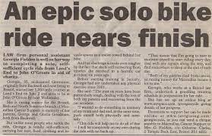
Directed Reading-Thinking Activity
Notes:
Directed reading-thinking activity The teacher directs learners to look at a text's title and other information in the text (e.g., photos) and then asks learners to predict the content of the text. For example, if the headline of an adult literacy newspaper article is Home Loan Rates Hit New Low, learners can predict that article will contain information on past and current loan rates as well as statements from financial experts on why the rates have changed. After the pre-reading activity, learners read to an agreed-on stopping point, review their predictions, and make new ones. Learners can make their predictions orally, in writing, or graphically. Teachers should model the approach before having learners do the activity independently.

Slide 12
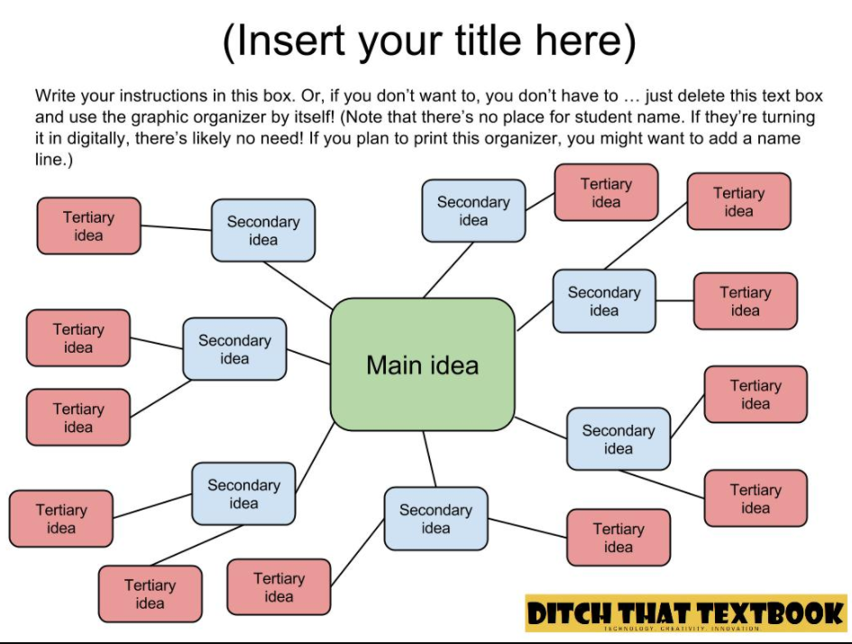
Graphic Organizers
Notes:
Graphic and semantic organizers Using charts with a variety of structures (e.g., boxes, circles, arrows), teachers help learners create visual representations of the ideas and relationships in a text.

Slide 13

Highlighting
Notes:
Highlighting Teachers model using different colors of highlighters to mark different aspects of the text. For example, teachers and learners highlight key sentences, vocabulary words, and plot turning points. Highlighters should be used to consciously mark parts of the text rather than as a rote mechanical task. Students may overuse highlighting, so teachers are advised to model and encourage its strategic use.

Slide 14
Breakout Room Activity: Sample Text
Spend 2 minutes reading the “Heavy Metal” article
In groups, discuss the comprehension questions
Select a representative from your group to share “AHA” moments, reflections, or thoughts
Notes:
https://abspd.appstate.edu/sites/abspd.appstate.edu/files/inst_pics/Vocabulary%20Fuzzy%20Word%20New.pdf

Slide 15
Teaching Strategies for Reading Comprehension
Using Imagination
K-W-L Activity
Prompts
Notes:
Using Imagination Teachers work with learners to model how to use imagination when reading. While reading a text aloud, the instructor stops and asks learners to imagine the scene being described. For example, when reading a passage about working in a coalmine, the teacher asks questions such as, What does the tunnel look like? What kind of light is there in the tunnel? How does the tunnel smell? What does the machinery sound like?
K-W-R-L Activity Learners examine what they Know, what they Want to know, what Resources are available to extend their knowledge, and how they will show what they have Learned. The first two questions are the same as the above K-W-L activity. In this variation, however, learners identify a variety of texts that address their topic by asking themselves What resources are available? The final question encourages them to demonstrate independent use of texts. They respond to, How will I show what I have learned?
Prompts - The title of/section heading in/picture in this article makes me think it’s about . . . - Reading this may help me find out . . . - I see now! After reading this paragraph, I get a better understanding of what the author said earlier when she was talking about . . . - This is not making sense. Here’s what I do know . . . - This is not making sense. Here is what I can do to help me understand it better . . . - I could re-read this section to find out . . . - Since I do not understand this word, I could use one of my fix up strategies to . . . - This is like . . . - This reminds me of . . . - Reading this made me think about . . .

Slide 16

Using Imagination
Notes:
Using Imagination Teachers work with learners to model how to use imagination when reading. While reading a text aloud, the instructor stops and asks learners to imagine the scene being described. For example, when reading a passage about working in a coalmine, the teacher asks questions such as, What does the tunnel look like? What kind of light is there in the tunnel? How does the tunnel smell? What does the machinery sound like?

Slide 17
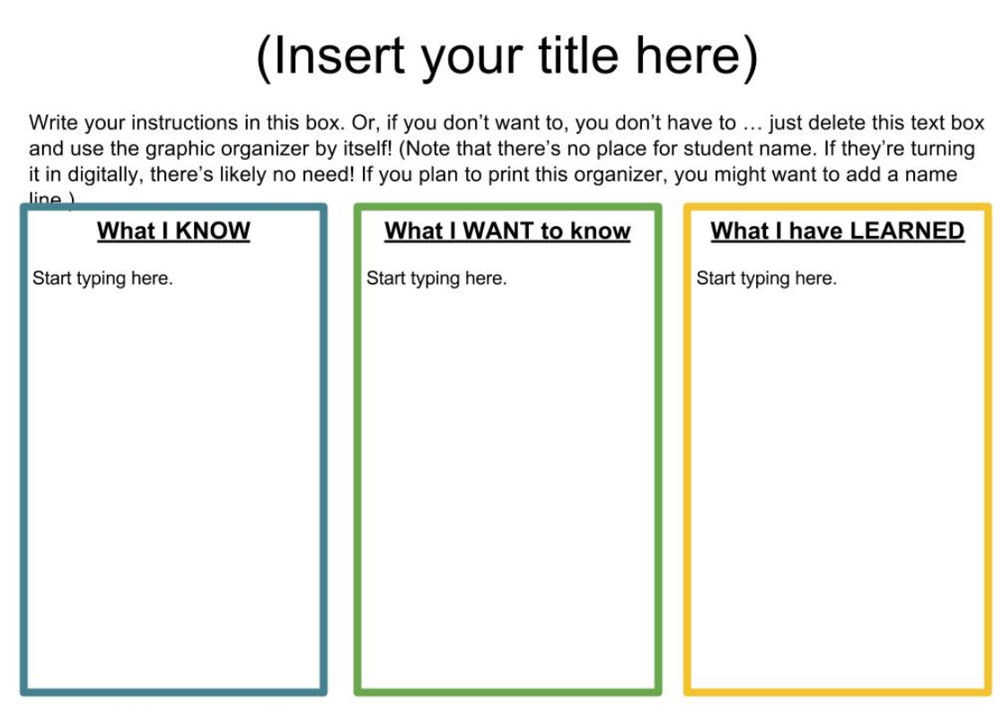
K-W-L Activity
Notes:
K-W-L Activity Learners examine what they Know, what they Want to know, what how they will show what they have Learned. The first two questions are the same as the above K-W-L activity. In this variation, however, learners identify a variety of texts that address their topic by asking themselves What resources are available? The final question encourages them to demonstrate independent use of texts. They respond to, How will I show what I have learned?

Slide 18
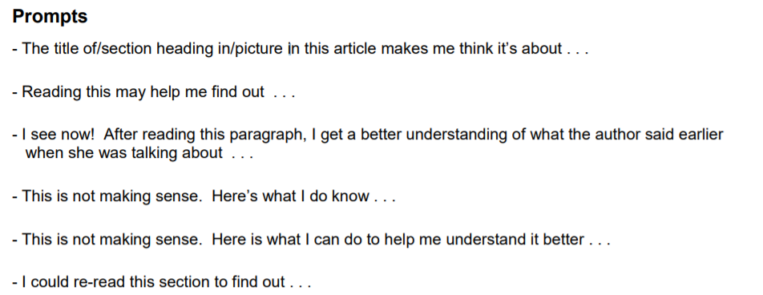
Prompts
Notes:
Prompts - The title of/section heading in/picture in this article makes me think it’s about . . . - Reading this may help me find out . . . - I see now! After reading this paragraph, I get a better understanding of what the author said earlier when she was talking about . . . - This is not making sense. Here’s what I do know . . . - This is not making sense. Here is what I can do to help me understand it better . . . - I could re-read this section to find out . . . - Since I do not understand this word, I could use one of my fix up strategies to . . . - This is like . . . - This reminds me of . . . - Reading this made me think about . . .

Slide 19
Online Resources for Reading Comprehension
NewsELA
Rewordify
Readtheory

Slide 20
Resources
https://abspd.appstate.edu/sites/abspd.appstate.edu/files/inst_pics/Comprehension%20Think%20Aloud%20Prompts%20817.pdf
https://ditchthattextbook.com/15-free-google-drawings-graphic-orgahighnizers-and-how-to-make-your-own/
https://www.valrc.org/learning/reading/lessons.html
https://lincs.ed.gov/professional-development/resource-collections/profile-435

Slide 21
Resources
https://abspd.appstate.edu/sites/abspd.appstate.edu/files/EBRI%20Resources%20Comprehension.pdf
https://abspd.appstate.edu/sites/abspd.appstate.edu/files/AdultReadingComprehension-1.pdf
https://abspd.appstate.edu/sites/abspd.appstate.edu/files/inst_pics/WIOA%20and%20components%20of%20reading.pdf

Slide 22
Questions?

Slide 23
Thank you for attending!

